Slide 1
Microsoft : Classifying Cybersecurity Incidents with Machine Learning
-BY
MATHESH .M

Slide 2
OBJECTIVE
Goal.
To develop a robust machine learning model that accurately predicts the triage grade of cybersecurity incidents (TP, BP, FP), enhancing the efficiency of Security Operation Centers (SOCs) and supporting guided response systems in prioritizing and mitigating threats effectively.
Industry.
Utilize the GUIDE dataset to preprocess data, handle class imbalances, and train a classification model evaluated using macro-F1 score, precision, and recall, ensuring reliable predictions for real-world cybersecurity applications.
Key Deliverables
A high-performing model capable of triaging incidents, comprehensive analysis and documentation of the process, and actionable recommendations for integration into SOC workflows.

Slide 3
DATASET OVERVIEW
The dataset, called GUIDE, is designed to support the classification of cybersecurity incidents into triage grades: True Positive (TP), Benign Positive (BP), and False Positive (FP). It consists of hierarchical data across three levels:
Evidence Level: Contains granular details like IP addresses, email, and user metadata supporting an alert.
Alert Level: Consolidates multiple pieces of evidence to signify potential security incidents, providing broader context.
Incident Level: Aggregates one or more alerts, representing a cohesive narrative of a potential breach or threat.
The dataset includes 8 lakh triage-annotated incidents with 45 features, labels, and unique identifiers. It is split into a training set (70%) and a test set (30%), stratified by triage grades, OrgId, and DetectorId to ensure consistency and relevance in model training and testing.

Slide 4
DATA CLEANING AND PREPROCESSING
Handle Missing Values
Identify Missing Data:
Check for missing values in the dataset using methods like isnull() or info()
Impute or Remove:
Use mean, median, or mode for numerical features
Drop rows or columns with excessive missing values, if justified
2. Handle Duplicates
Identify and remove duplicate rows using drop_duplicates() to avoid redundant information.
3. Feature Engineering.
Timestamp Features:
Extract time-based features (e.g., hour, day of the week, month) from timestamp columns
Correlation Analysis
Analyzed feature correlations using a heatmap and removed features with high inter-correlation (|correlation| > 0.9) to reduce redundancy.

Slide 5
DATA CLEANING AND PREPROCESSING
4. Encoding Categorical Variables
Use One-Hot Encoding for nominal categorical features with few categories
Use Label Encoding for ordinal features or categorical features with a high cardinality
5. Address Class Imbalance
Apply techniques like SMOTE (Synthetic Minority Oversampling Technique), class weighting, or undersampling to balance the dataset
6. Scaling and Normalization
I used MinMaxScaler to scale all numerical features to a range of [0, 1], ensuring that all features contribute equally during model training.
This normalization is particularly useful for algorithms sensitive to feature scales, such as distance-based models or gradient-based optimizers
7. Outlier Detection and Handling
Handle outliers by capping, transforming, or removing them, depending on their impact on model performance
Use statistical methods (e.g., Z-score, IQR) or visualization (boxplots) to identify outliers

Slide 6
MODEL SELECTION AND TRAINING
Logistic Regression
logreg = LogisticRegression(solver='liblinear')
Random forest model
dtree = DecisionTreeClassifier(random_state=42)
Decision Tree Model
rf = RandomForestClassifier(random_state=42)
Gradient Boosting Machines – XGBoost
xgb_model = xgb.XGBClassifier(random_state=42, use_label_encoder=False, eval_metric='logloss’)
I trained and evaluated four models: Logistic Regression, Decision Tree, Random Forest, and XGBoost, each configured with appropriate parameters for optimal performance. The models were assessed using macro-F1 score, precision, and recall to ensure balanced predictions across all classes. Based on the evaluation, the best-performing model was selected for final deployment.

Slide 7
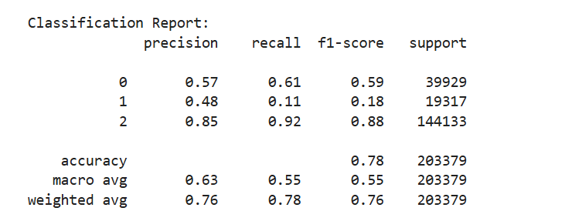
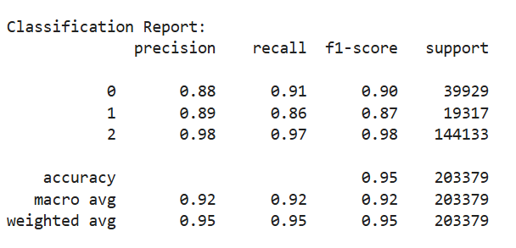
MACHINE LEARNING MODELS RESULTS
LOGISTIC REGRESSION RESULTS
DECISION TREE MODEL RESULTS

Slide 8
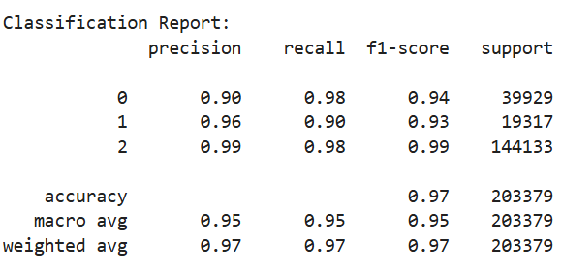
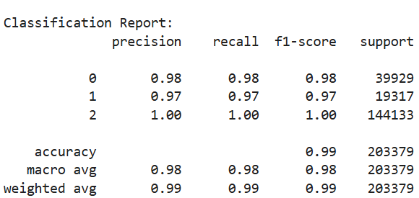
MACHINE LEARNING MODELS RESULTS
RANDOM FOREST MODEL RESULTS
GRADIENT BOOSTING-XG BOOST

Slide 9
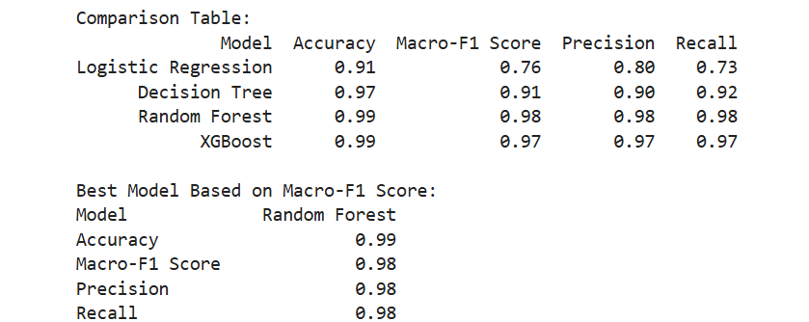
OVERALL REPORT AND COMPARISON

Slide 10
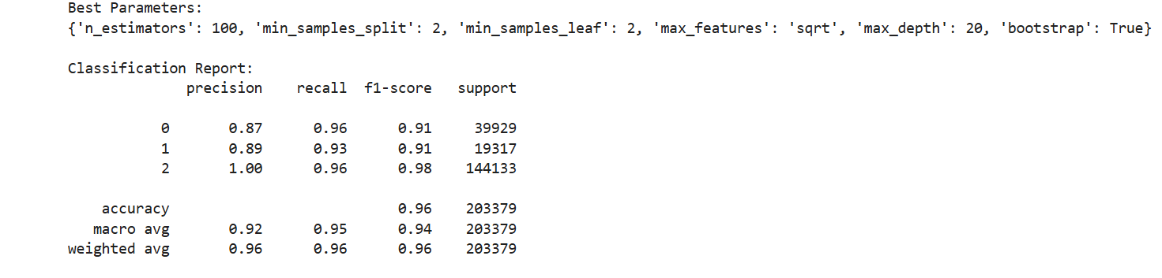
Optimized Random Forest Classifier for Imbalanced Dataset Prediction
Implemented a Random Forest Classifier to predict incident gradient in an imbalanced dataset. Used SMOTE for handling class imbalance and optimized hyperparameters using RandomizedSearchCV with stratified cross-validation. Achieved 96% accuracy with strong F1-scores across all classes, as shown in the classification report and confusion matrix. Saved the best model as a pickle file for future use

Slide 11
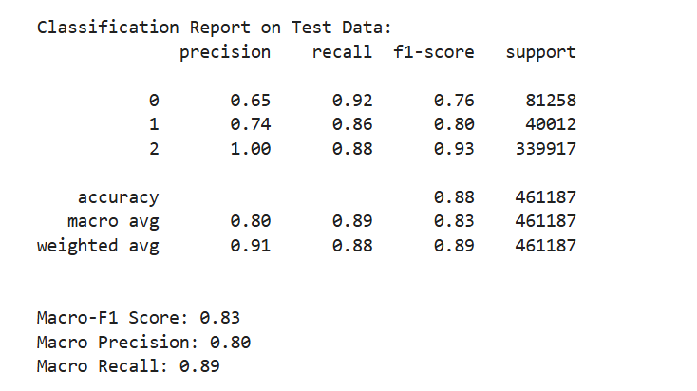
Test Data Evaluation of Optimized Random Forest Model
Using the best model saved as a pickle file, the Random Forest Classifier was evaluated on test data, achieving an overall accuracy of 88%.
The model performed well across all classes, with a Macro F1-Score of 0.83, Macro Precision of 0.80, and Macro Recall of 0.89, indicating balanced performance in predicting multiple classes.
The classification report highlights high recall for class 0 and excellent precision for class 2, showcasing the model's ability to handle imbalanced test data effectively.

Slide 12
CHALLENGES ,SOLUTIONS,LEARNINGS
Challenges:
Preparing the data for effective training, including handling missing values, outliers, and resampling, required careful attention
Optimizing the Random Forest hyperparameters with a large search space and limited computational resources was time-consuming
The Random Forest model, coupled with SMOTE and cross-validation, resulted in extended training durations
Solutions
Implemented SMOTE (Synthetic Minority Oversampling Technique) to balance the training dataset, ensuring fair representation of all classes
Used RandomizedSearchCV with a focused parameter grid and reduced iterations, leveraging StratifiedKFold to optimize performance efficiently
Reduced the number of trees and limited the parameter grid to manage computational complexity while maintaining performance
Learnings.
Importance of Handling Imbalanced Data
Hyperparameter Tuning Strategies.
Time and Resource Management.
Model Evaluation Metrics

Slide 13
CONCLUSION.
The Microsoft project was a comprehensive learning experience in tackling real-world challenges in machine learning. By addressing issues such as class imbalance, hyperparameter tuning, and ensuring generalization, the project demonstrated the practical application of advanced techniques like SMOTE and RandomizedSearchCV. The optimized Random Forest model achieved impressive performance metrics, reflecting its robustness and reliability for multi-class classification tasks. Through this process, I enhanced my understanding of handling imbalanced datasets, fine-tuning models, and deploying them efficiently. This project solidified my technical expertise and problem-solving skills, preparing me for future challenges in machine learning and data science

Slide 14
THANK
YOU

